Slide 1
Supervised Classification
Bayesian classification

Slide 2
Bayesian Classification
A statistical classifier: performs probabilistic prediction, i.e., predicts class membership probabilities
Foundation: Named after Thomas Bayes, who proposed the Bayes Theorem.
Performance:
  It can solve problems involving both categorical and continuous valued attributes.
  A simple Bayesian classifier, naïve Bayesian classifier, has comparable performance with that of decision tree and some neural network classifiers

Slide 3
Bayesian Theorem: Basics
Let X be a data sample
Let H be a hypothesis that X belongs to class C
Classification is to determine P(H|X), the probability that the hypothesis holds given the observed data sample X
  Example: customer X will buy a computer given that the customer’s age and income are known

Slide 4
Bayesian Theorem: Basics
P(H) (prior probability), the initial probability
  E.g., X will buy computer, regardless of age, income, …
P(X) (evidence): probability that sample data is observed
P(X|H) (likelihood), the probability of observing the sample X, given that the hypothesis holds
  E.g., Given the hypothesis is that X will buy computer, then P(X|H) denotes the prob. that Age of X is between 31…40, having medium income

Slide 5
Bayesian Theorem
Given training data X, posteriori probability of a hypothesis H, P(H|X), follows the Bayes theorem

Slide 6
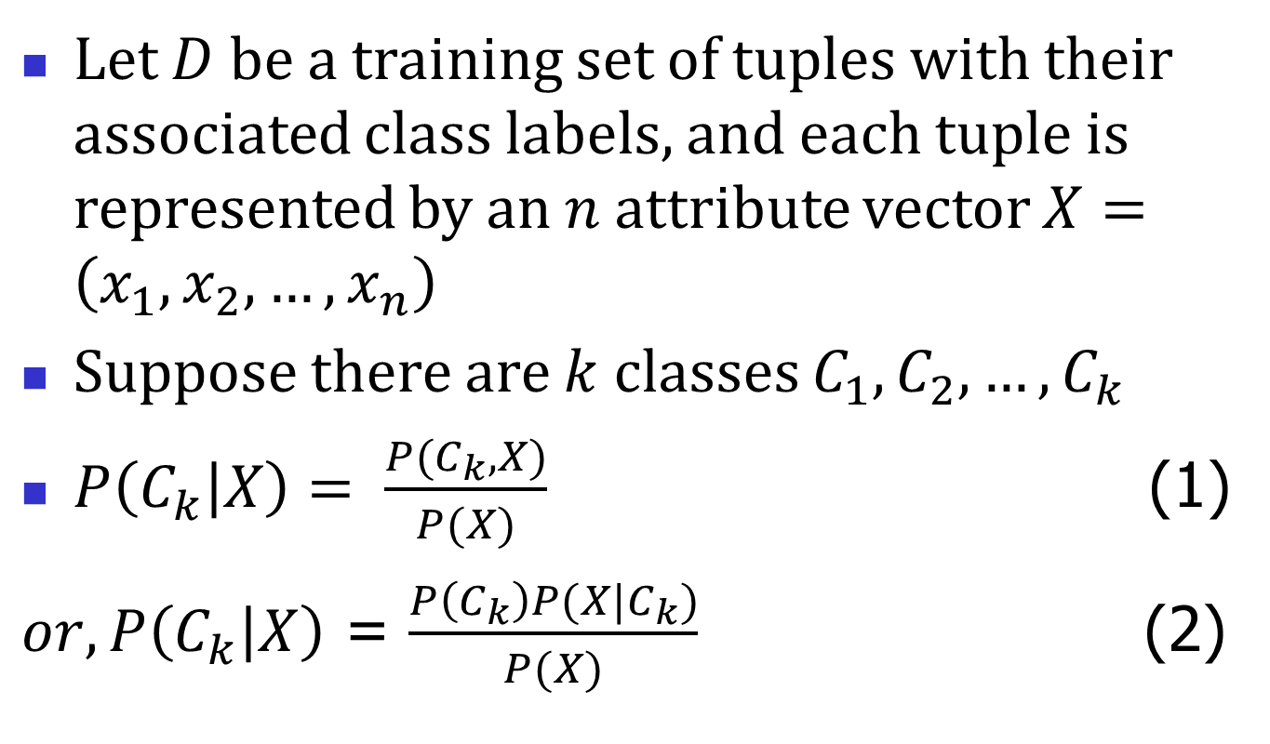
Let $D$ be a training set of tuples with their associated class labels, and each tuple is represented by an $n$ attribute vector $X=\left(x_{1},x_{2},…,x_{n}\right)$
Suppose there are $k$ classes $C_{1},C_{2},…,C_{k}$
$P\left(C_{k} | X\right)= \frac{P(C_{k}, X)}{P(X)}$ (1)
$or, P\left(C_{k} | X\right)$ = $\frac{P\left(C_{k}\right)P(X|C_{k})}{P(X)}$ (2)

Slide 7
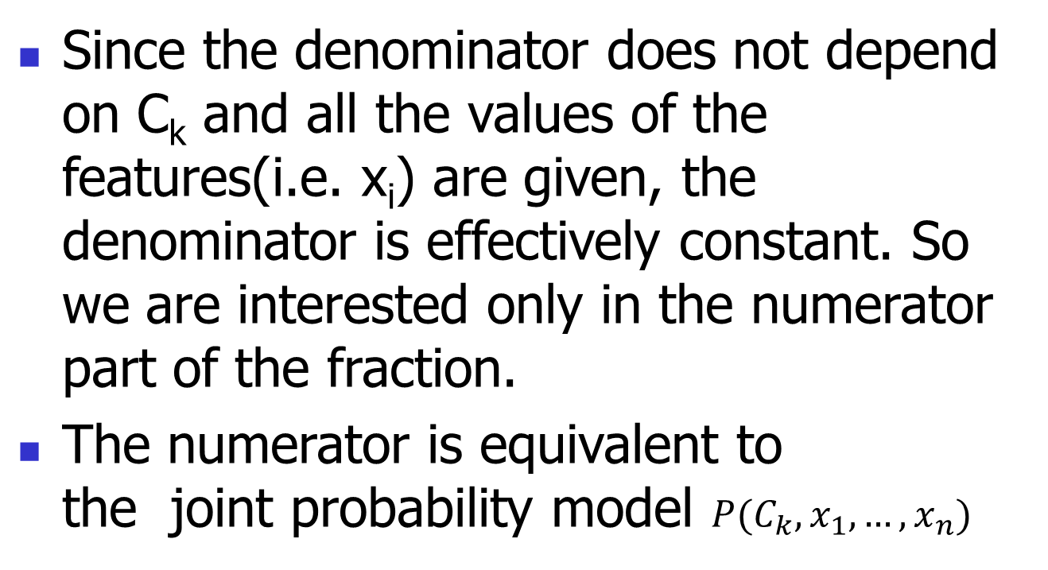
Since the denominator does not depend on C_{k} and all the values of the features(i.e. x_{i}) are given, the denominator is effectively constant. So we are interested only in the numerator part of the fraction.
The numerator is equivalent to the joint probability model $P(C_{k},x_{1},…,x_{n})$

Slide 8

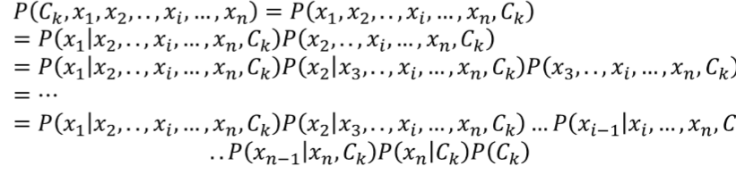
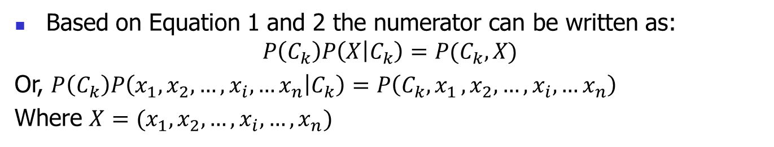
Based on Equation 1 and 2 the numerator can be written as:
$$P\left(C_{k}\right)P\left(X | C_{k}\right)=P(C_{k},X)$$
Or, $P\left(C_{k}\right)P\left(x_{1},x_{2},…,x_{i},…x_{n} | C_{k}\right)=P\left(C_{k}{,x}_{1},x_{2},…,x_{i},…x_{n}\right)$
Where $X=(x_{1},x_{2},…,x_{i}, …,x_{n})$

Slide 9
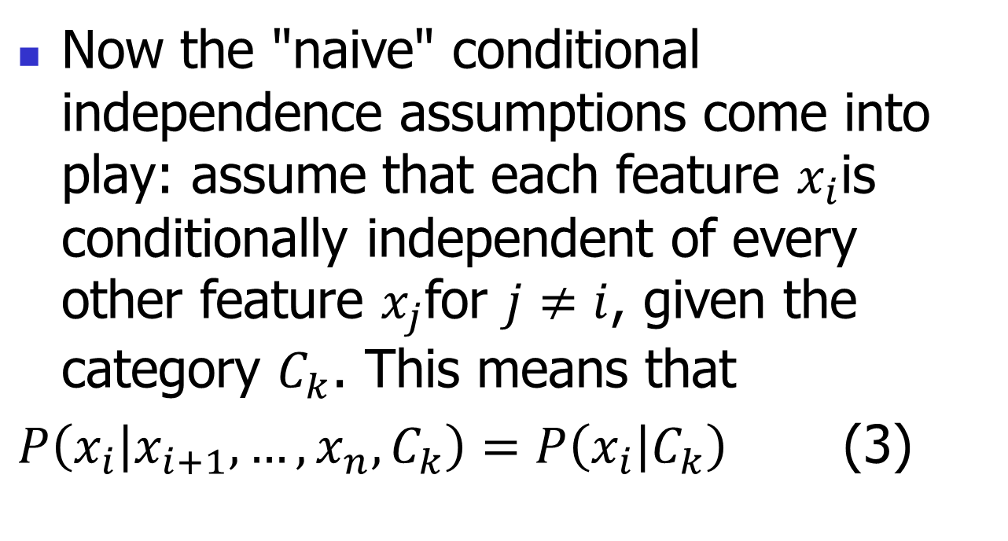
Now the "naive" conditional independence assumptions come into play: assume that each feature $x_{i}$is conditionally independent of every other feature $x_{j}$for $j≠i$, given the category $C_{k}$. This means that
$P\left(x_{i} | x_{i+1},…,x_{n},C_{k}\right)=P\left(x_{i} | C_{k}\right)$ (3)

Slide 10
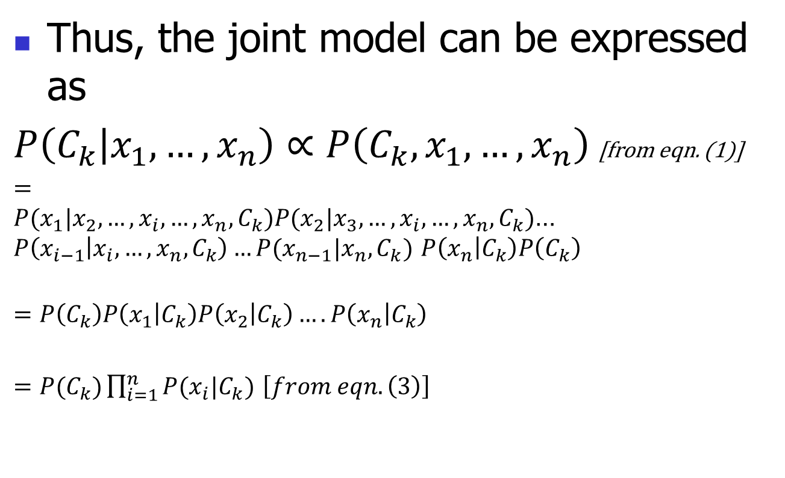
Thus, the joint model can be expressed as
$P\left(C_{k} | x_{1},…, x_{n}\right)∝P\left(C_{k},x_{1},…,x_{n}\right)$ [from eqn. (1)]
$=P(x_{1}|x_{2},…,x_{i},…,x_{n},C_{k})P(x_{2}|x_{3},…,x_{i},…,x_{n},C_{k})$…$P\left(x_{i−1} | x_{i}, …,x_{n},C_{k}\right)…P(x_{n−1}|x_{n},C_{k})$ $P\left(x_{n} | C_{k}\right)P\left(C_{k}\right)$
$$=P\left(C_{k}\right)P\left(x_{1} | C_{k}\right)P\left(x_{2} | C_{k}\right)….P\left(x_{n} | C_{k}\right)$$
$=P(C_{k})\prod_{i=1}^{n}{P(x_{i}|C_{k})}$ $\left[from eqn. \left(3\right)\right]$

Slide 11
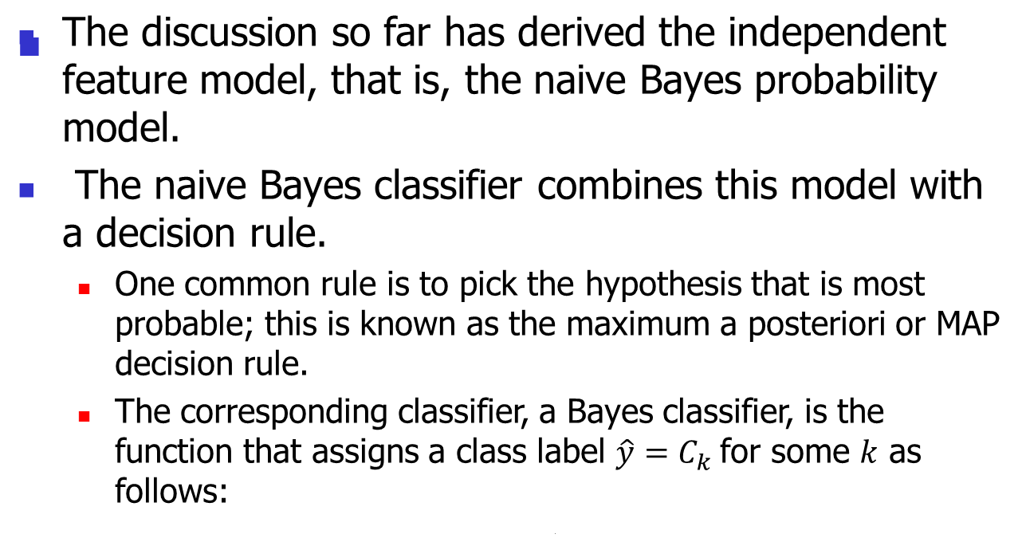
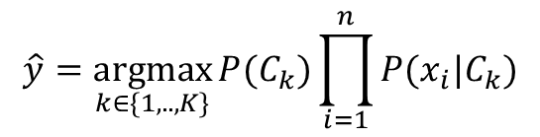
Constructing a classifier from the probability model

Slide 12
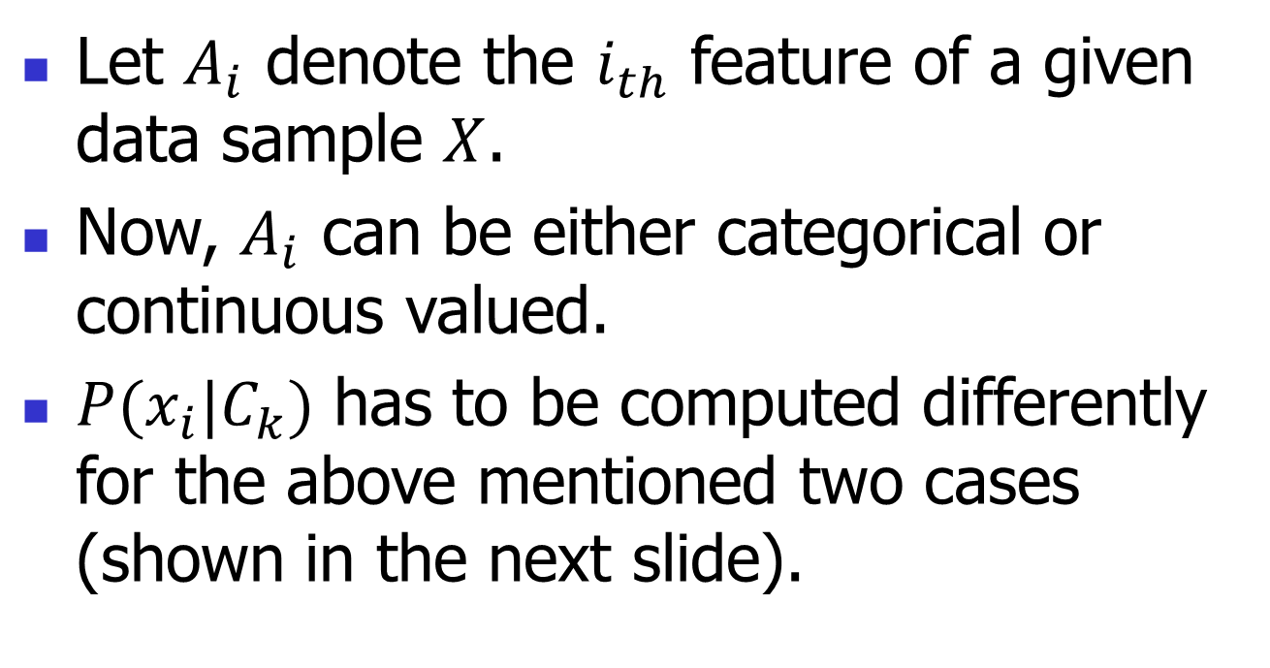
Towards Naïve Bayesian Classifier
Let $A_{i}$ denote the $i_{th}$ feature of a given data sample $X$.
Now, $A_{i}$ can be either categorical or continuous valued.
$P(x_{i}|C_{k})$ has to be computed differently for the above mentioned two cases (shown in the next slide).

Slide 13
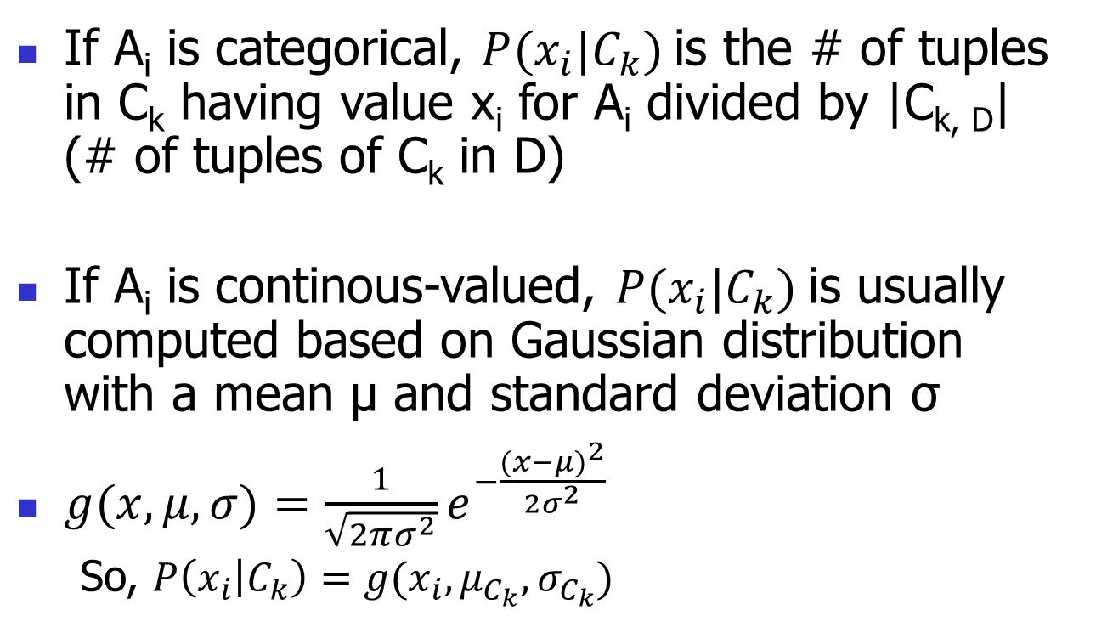
Towards Naïve Bayesian Classifier

Slide 14
Naïve Bayesian Classifier: Training Dataset
Age Group | Income | Student | Credit_rating | Class: buys_laptop
Youth | High | No | Fair | No
Youth | High | No | Excellent | No
Middle_aged | High | No | Fair | Yes
Senior | Medium | No | Fair | Yes
Senior | Low | Yes | Fair | Yes
Senior | Low | Yes | Excellent | No
Middle_aged | Low | Yes | Excellent | yes
Youth | Medium | No | Fair | No
Youth | Low | Yes | Fair | Yes
Senior | Medium | Yes | Fair | Yes
Youth | Medium | Yes | Excellent | Yes
Middle_aged | Medium | No | Excellent | Yes
Middle_aged | High | Yes | Fair | Yes
Senior | Medium | No | Excellent | No

Slide 15
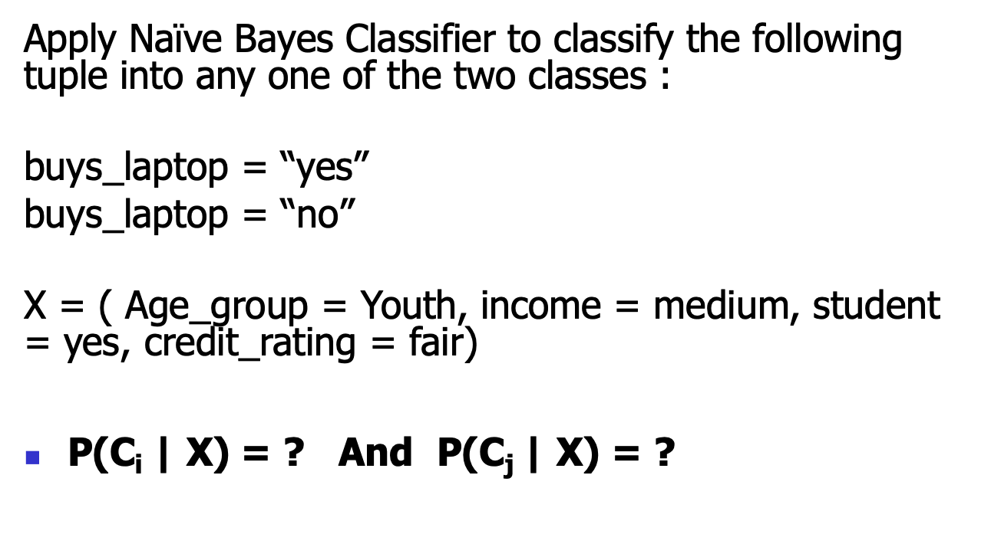
Apply Naïve Bayes Classifier to classify the following tuple into any one of the two classes :
buys_laptop = “yes”
buys_laptop = “no”
X = ( Age_group = Youth, income = medium, student = yes, credit_rating = fair)
P(C_{i} | X) = ? And P(C_{j} | X) = ?

Slide 16
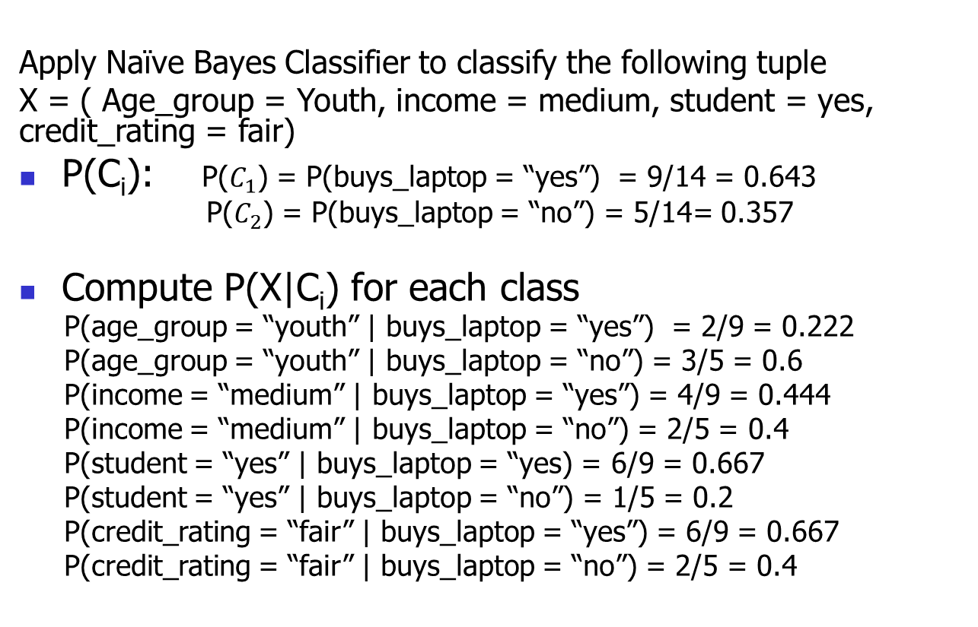
Naïve Bayesian Classifier: An Example
Apply Naïve Bayes Classifier to classify the following tuple
X = ( Age_group = Youth, income = medium, student = yes, credit_rating = fair)
P(C_{i}): P($C_{1}$) = P(buys_laptop = “yes”) = 9/14 = 0.643
P($C_{2}$) = P(buys_laptop = “no”) = 5/14= 0.357
Compute P(X|C_{i}) for each class
P(age_group = “youth” | buys_laptop = “yes”) = 2/9 = 0.222
P(age_group = “youth” | buys_laptop = “no”) = 3/5 = 0.6
P(income = “medium” | buys_laptop = “yes”) = 4/9 = 0.444
P(income = “medium” | buys_laptop = “no”) = 2/5 = 0.4
P(student = “yes” | buys_laptop = “yes) = 6/9 = 0.667
P(student = “yes” | buys_laptop = “no”) = 1/5 = 0.2
P(credit_rating = “fair” | buys_laptop = “yes”) = 6/9 = 0.667
P(credit_rating = “fair” | buys_laptop = “no”) = 2/5 = 0.4

Slide 17
Naïve Bayesian Classifier: An Example
P(X|C_{i}) :
P(X|buys_laptop = “yes”) = 0.222 x 0.444 x 0.667 x 0.667 = 0.044
P(X|buys_laptop = “no”) = 0.6 x 0.4 x 0.2 x 0.4 = 0.019
P(X|C_{i})*P(C_{i}) : P(X|buys_laptop = “yes”) * P(buys_laptop = “yes”) = 0.028
P(X|buys_laptop = “no”) * P(buys_laptop = “no”) = 0.007
Therefore, X belongs to class (“buys_laptop = yes”)

Slide 18
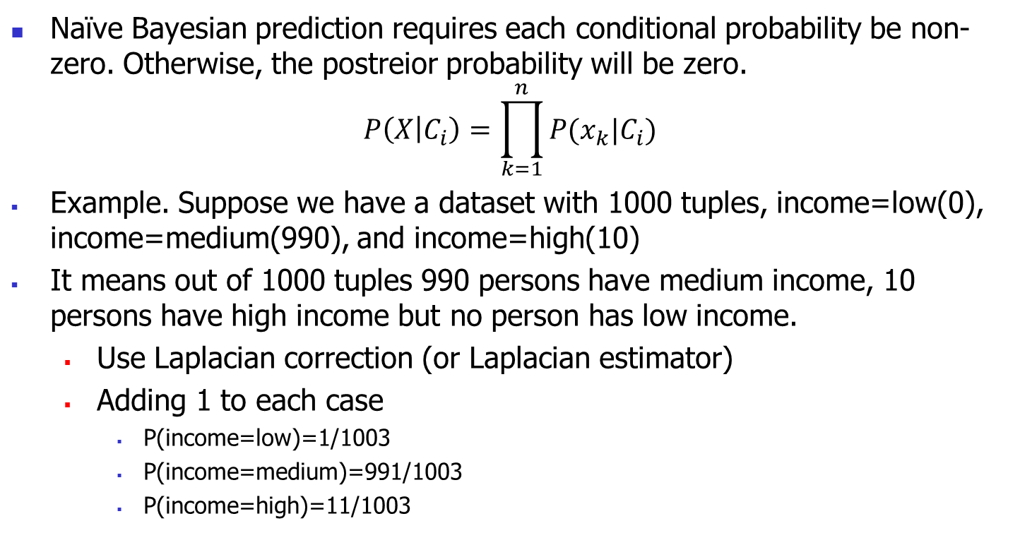
Avoiding the 0-Probability Problem
Naïve Bayesian prediction requires each conditional probability be non-zero. Otherwise, the postreior probability will be zero.
$$P\left(X | C_{i}\right)=\prod_{k=1}^{n}{P(x_{k}|C_{i})}$$
Example. Suppose we have a dataset with 1000 tuples, income=low(0), income=medium(990), and income=high(10)
It means out of 1000 tuples 990 persons have medium income, 10 persons have high income but no person has low income.
  Use Laplacian correction (or Laplacian estimator)
  Adding 1 to each case
    P(income=low)=1/1003
    P(income=medium)=991/1003
    P(income=high)=11/1003

Slide 19
Naïve Bayesian Classifier
Advantages
  Easy to implement
  Good results obtained in most of the cases
Disadvantages
  Assumption: class conditional independence, Not always valid for real life problems, since dependencies do exist among variables
    E.g., hospitals, patient’s name, age, family history, etc.
  Dependencies among these cannot be modeled by Naïve Bayesian Classifier

Slide 20
Advantage of Naïve Bayes over KNN and Decision Tree
Naïve Bayes Over KNN
  KNN doesn't know which attributes are more important. As a result of that, While computing distance between data points (usually Euclidean distance or other generalizations of it), each attribute normally weighs the same to the total distance. This means that attributes which are not so important will have the same influence on the distance compared to more important attributes.
  Naïve Bayes is one of the classifiers that handle missing data very well, it just excludes the attribute with missing data when computing posterior probability (i.e. probability of class given data point). With KNN, one can't do classification if there is any missing data. The reason is that, distance is undefined if one or more of attributes (which are essentially dimensions) are missing, unless these attributes are being omitted while computing distance. As a consequence, we need to rely on common solutions for missing data, e.g. imputing average values.
  KNN needs one parameter more than Naïve Bayes. This is the number of neighbors (K). This means one need to do model selection for KNN in order to determine the best values for K.

Slide 21
Advantage of Naïve Bayes over KNN and Decision Tree
  KNN classifier is a supervised lazy classifier which has local heuristics. Being a lazy classifier, it is difficult to use this for prediction in real time. On the other hand, Naive Bayes is much faster than KNN. Thus, it could be used for prediction in real time.
  Naïve Bayes over Decision Tree
  Decision tree has a tendency to be over fitted with the training data.
  Decision tree are not generally suitable for application like diagnosis of Cancer. As Cancer doesn't occur in the population in large numbers, it may get pruned out more likely by decision tree.

Slide 22
Bayesian network
A Bayesian network is a probabilistic graphical model that represents a set of variables and their conditional dependencies via a directed acyclic graph (DAG).
For example, a Bayesian network could represent the probabilistic relationships between diseases and symptoms. Given symptoms, the network can be used to compute the probabilities of the presence of various diseases.

Slide 23
Formally, Bayesian networks are DAGs whose nodes represent variables in the Bayesian sense: they may be observable quantities, latent variables, unknown parameters or hypotheses.
Edges represent conditional dependencies.

Slide 24
Nodes that are not connected represent variables that are conditionally independent of each other.
Each node is associated with a probability function that takes, as input, a particular set of values for the node's parent variables, and gives (as output) the probability (or probability distribution, if applicable) of the variable represented by the node.

Slide 25
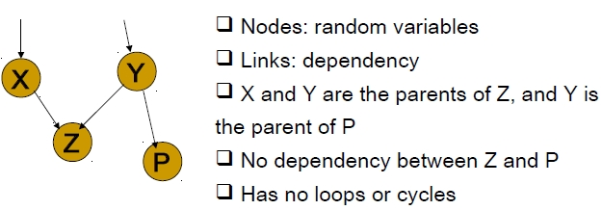
Bayesian Belief Networks
A graphical model of causal relationships
  Represents dependency among the variables
  Gives a specification of joint probability distribution

Slide 26
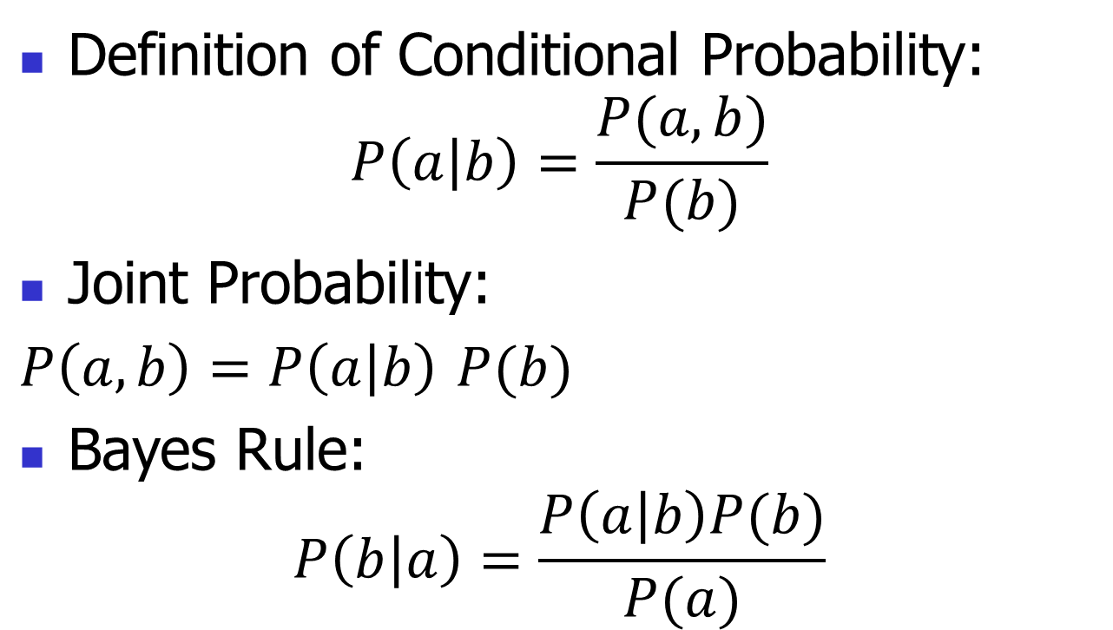
Definition of Conditional Probability:
$$P\left(a | b\right)=\frac{P(a,b)}{P(b)}$$
Joint Probability:
$P\left(a,b\right)=P\left(a | b\right)$ $P(b)$
Bayes Rule:
$$P\left(b | a\right)=\frac{P\left(a | b\right)P(b)}{P(a)}$$

Slide 27
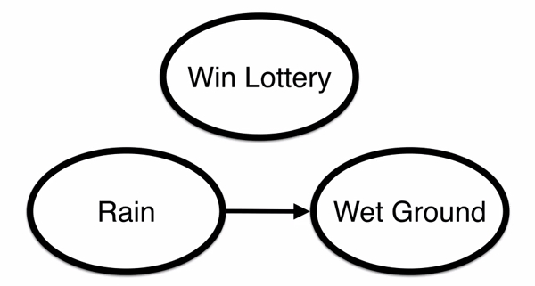
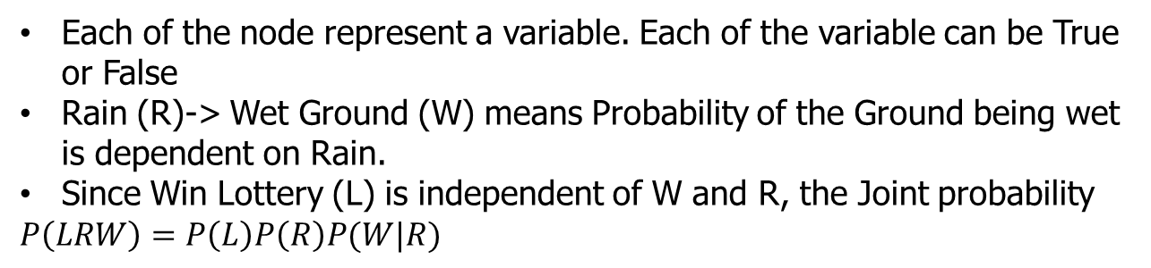
Bayesian Network
Each of the node represent a variable. Each of the variable can be True or False
Rain (R)-> Wet Ground (W) means Probability of the Ground being wet is dependent on Rain.
Since Win Lottery (L) is independent of W and R, the Joint probability
$P\left(LRW\right)=P\left(L\right)P\left(R\right)P(W|R)$

Slide 28
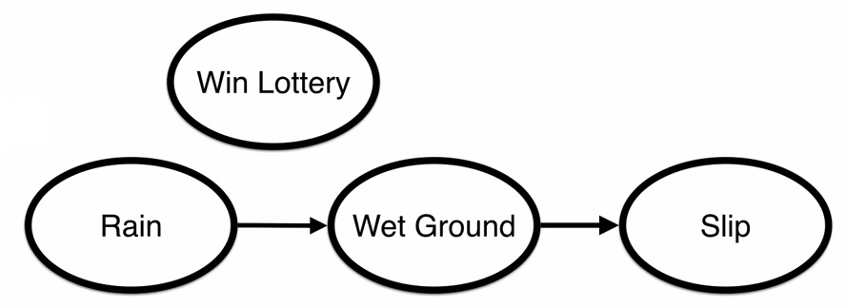
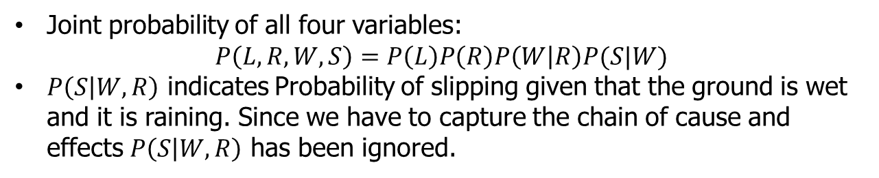
Bayesian Network
Joint probability of all four variables:
$$P\left(L,R,W,S\right)=P\left(L\right)P\left(R\right)P\left(W | R\right)P(S|W)$$
$P\left(S | W,R\right)$ indicates Probability of slipping given that the ground is wet and it is raining. Since we have to capture the chain of cause and effects $P\left(S | W,R\right)$ has been ignored.

Slide 29
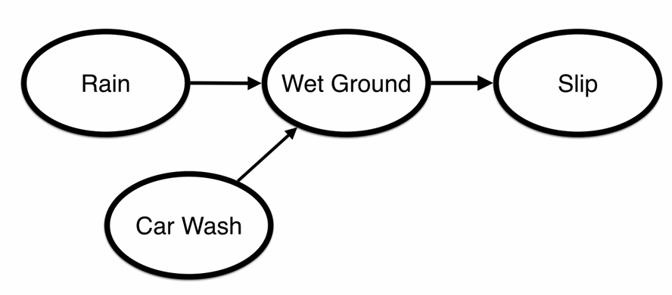
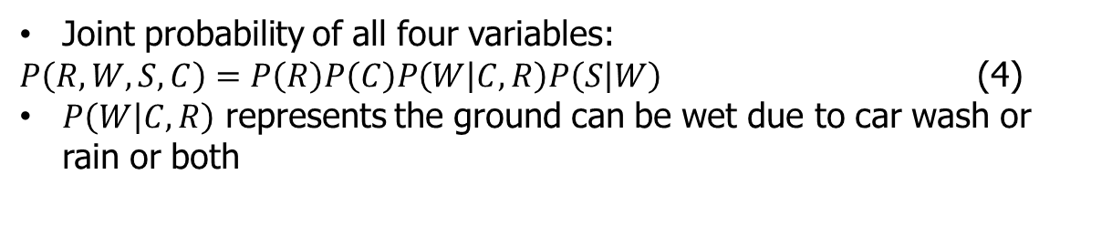
Bayesian Network
Joint probability of all four variables:
$P\left(R,W,S,C\right)=P\left(R\right)P\left(C\right)P\left(W | C,R\right)P\left(S | W\right)$ (4)
$P\left(W | C,R\right)$ represents the ground can be wet due to car wash or rain or both

Slide 30
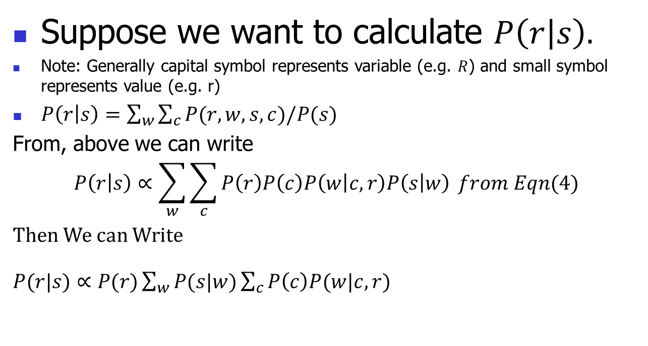
Inference in Bayesian network
Suppose we want to calculate $P\left(r | s\right).$
Note: Generally capital symbol represents variable (e.g. $R$) and small symbol represents value (e.g. r)
$P\left(r | s\right)=\sum_{w}{\sum_{c}{P(r,w,s,c)/P(s)}}$
From, above we can write
$$P\left(r | s\right)∝\sum_{w}{\sum_{c}{P\left(r\right)P\left(c\right)P\left(w | c,r\right)P\left(s | w\right)}} from Eqn(4)$$
Then We can Write
$P(r|s)∝P(r)\sum_{w}{P(s|w)\sum_{c}{P\left(c\right)P(w|c,r)}}$

Slide 31
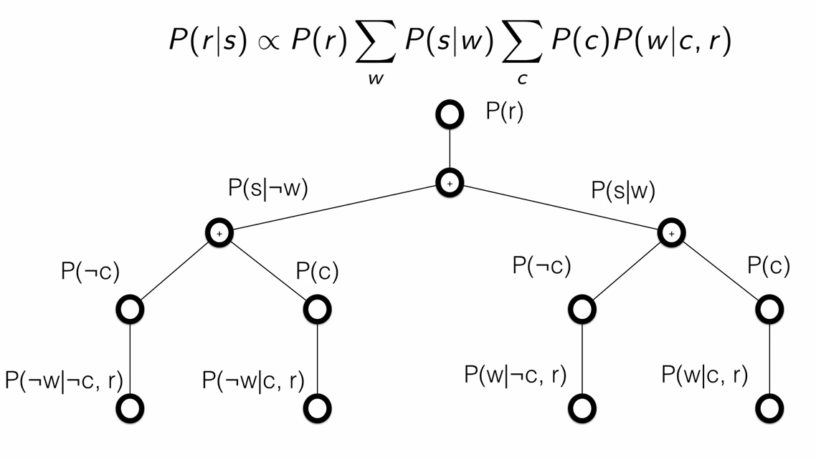
Evaluation Tree

Slide 32
An example with conditional probability tables (CPT)
Suppose that there are two events which could cause grass to be wet: either the sprinkler is on or it's raining.
Also, suppose that the rain has a direct effect on the use of the sprinkler (namely that when it rains, the sprinkler is usually not turned on).
Then the situation can be modelled with a Bayesian network (shown to the right). All three variables have two possible values, T (for true) and F (for false).

Slide 33
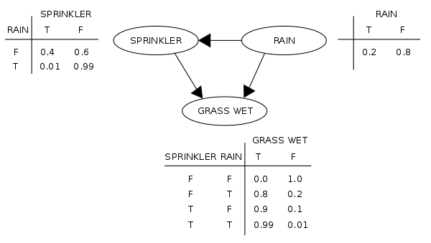
A simple Bayesian network with conditional probability tables

Slide 34
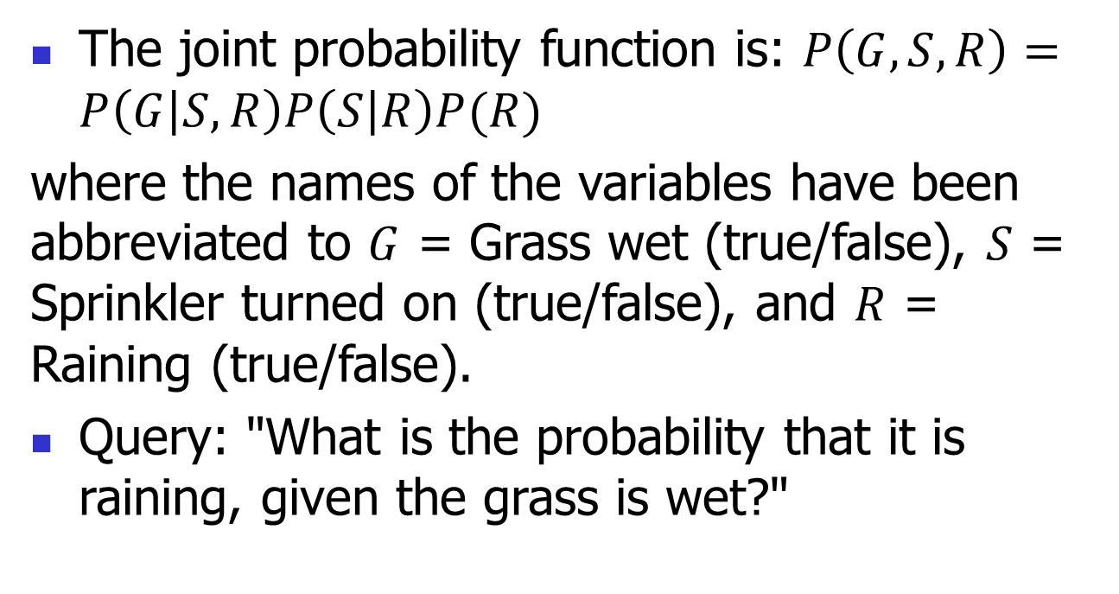
The joint probability function is: $P\left(G,S,R\right)=P\left(G | S,R\right)P\left(S | R\right)P(R)$
where the names of the variables have been abbreviated to $G$ = Grass wet (true/false), $S$ = Sprinkler turned on (true/false), and $R$ = Raining (true/false).
Query: "What is the probability that it is raining, given the grass is wet?"

Slide 35
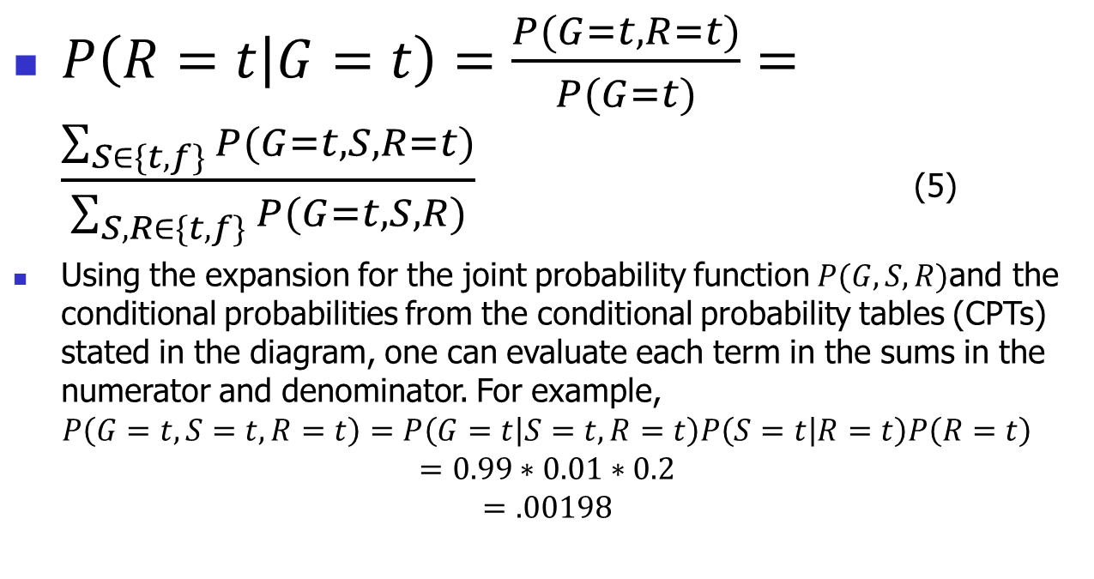
$P\left(R=t | G=t\right)=\frac{P(G=t,R=t)}{P(G=t)}=\frac{\sum_{S∈\{t,f\}}{P(G=t,S,R=t)}}{\sum_{S,R∈\{t,f\}}{P(G=t,S,R)}}$ (5)
Using the expansion for the joint probability function $P(G,S,R)$and the conditional probabilities from the conditional probability tables (CPTs) stated in the diagram, one can evaluate each term in the sums in the numerator and denominator. For example,
$$P\left(G=t,S=t,R=t\right)=P\left(G=t | S=t,R=t\right)P\left(S=t | R=t\right)P\left(R=t\right)$$
$$=0.99∗0.01∗0.2$$
$$=.00198$$

Slide 36

From Eqn. 5
$$P\left(R=t | G=t\right)=\frac{{0.00198}_{ttt}+{0.1584}_{tft}}{{0.00198}_{ttt}+{0.288}_{ttf}+{0.1584}_{tft}+{0.0}_{tff}}=\frac{891}{2491}≈35.77\%$$

Slide 37
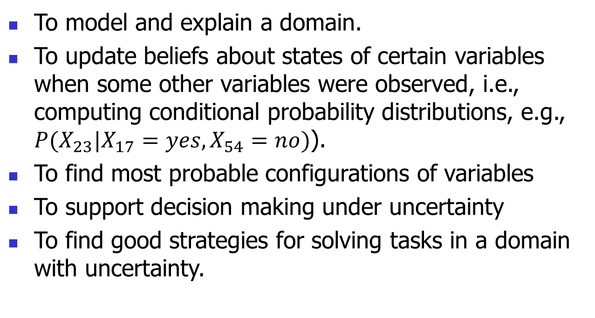
Typical Use of Bayesian networks
To model and explain a domain.
To update beliefs about states of certain variables when some other variables were observed, i.e., computing conditional probability distributions, e.g., $P(X_{23}|X_{17}=yes, X_{54}=no)$).
To find most probable configurations of variables
To support decision making under uncertainty
To find good strategies for solving tasks in a domain with uncertainty.

